Slide 1
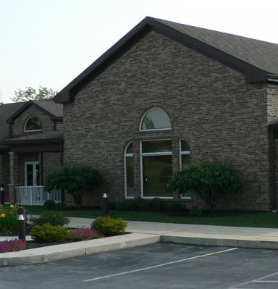

Middlesex Township
MS4 Permit Lunch & Learn
November 12, 2019

Slide 2
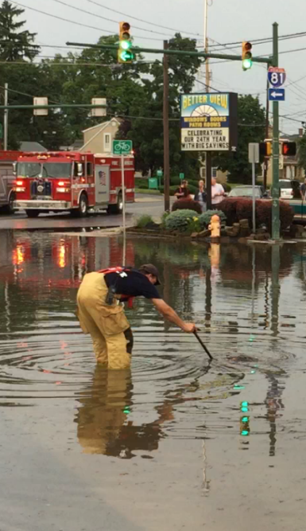
Today’s Topics
Stormwater
MS4 Permit
  Purpose
  Components
Roles and Responsibilities
Middlesex Achievements
Next Steps
Q&A
Notes:
This the introduction to the Middlesex Township Stormwater Management Program that responds to the Township’s MS4 Permit. We will be covering the listed topics. Some are basic and you are already familiar with the topic. Others might be head scratchers. So, feel free to ask questions as they arise.

Slide 3



Before we get started…
What do you know?
(“I don’t know” is OK ☺!)
What is Stormwater?
What is stormwater runoff?
Where does runoff go?
What does the acronym MS4 represent?
What is the MS4 Permit…Why is it needed?
How does the permit involve you?
Notes:
Let’s check the basics. What does this audience already know?
Have Eileen count hands for each question
Sequence:
Request a hand raise
How many don’t know?
Who does know?
How many agree?

Slide 4
Stormwater

Slide 5
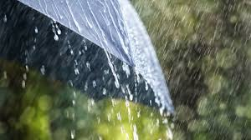
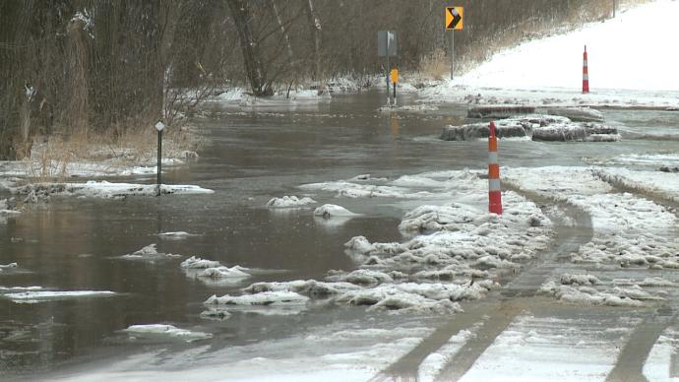
What is Stormwater?
Rain & Snow melt
https://blog.weatherops.com/hubfs/Brandon+snowmelt+flooding.jpg
Notes:
(Wait and then click) No trick questions here…rain and snow melt.

Slide 6
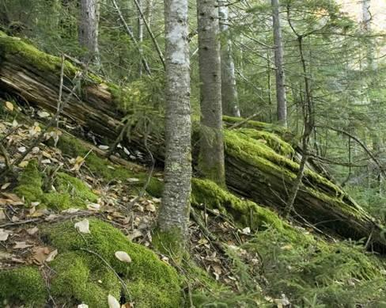
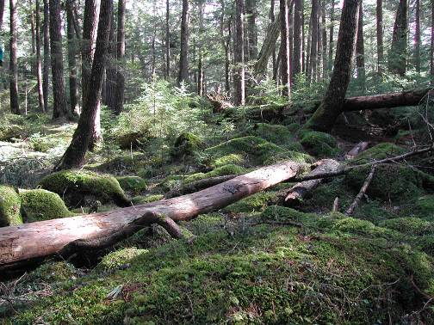
So…What is Stormwater Runoff?
Deep soils, complex Micro-topography, thick forest floor
= max depression storage
= maximum infiltration
Notes:
Surface runoff is minimal in undisturbed forests. Look at all the depressions and water-holding features caused by boulders, fallen trees, and depressions caused by fallen trees. In addition, the decaying leaves and soft ground soak up water, even on hillsides.

Slide 7
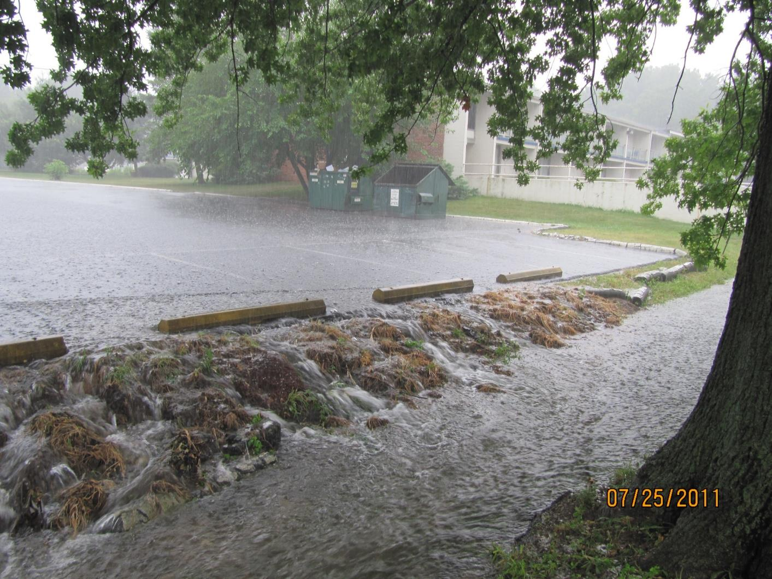
Stormwater Runoff
Pavement & Roofs
(Impervious Surfaces)
Prevent Infiltration
Notes:
Pavement prevents stormwater from soaking in…it RUNS OFF

Slide 8
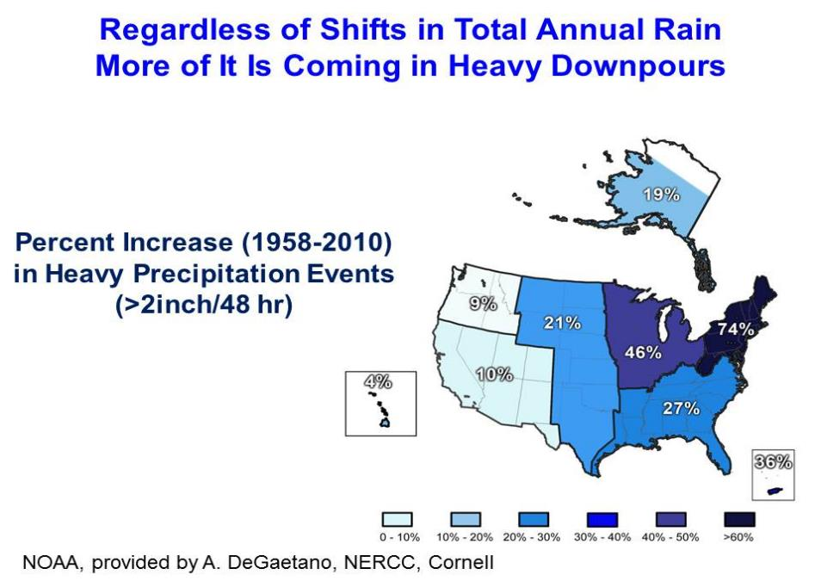
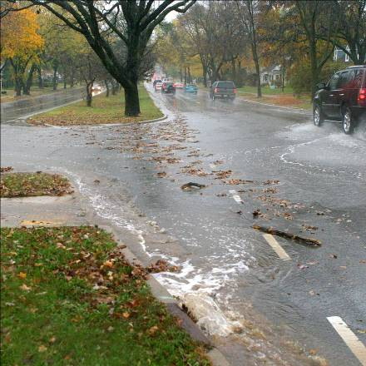
Heavier downpours = more flooding,
channel erosion, and pollution
The volatile urban
runoff regime
Notes:
A study by NOAA suggests that storm events are intensifying. While the region might still receive an average of 40 inches per year, more rain is occurring in heavy down pours. Stormwater cannot soak into the ground when it arrives too fast. Think of a bathtub drain. If the same volume of water is delivered to it in buckets instead of a trickle, the water cannot get into the drain. So, in areas where there is no or limited stormwater storage…stormwater basins, wetlands, floodplains and similar… these intensified storms increase the amount of rainwater that runs off.

Slide 9
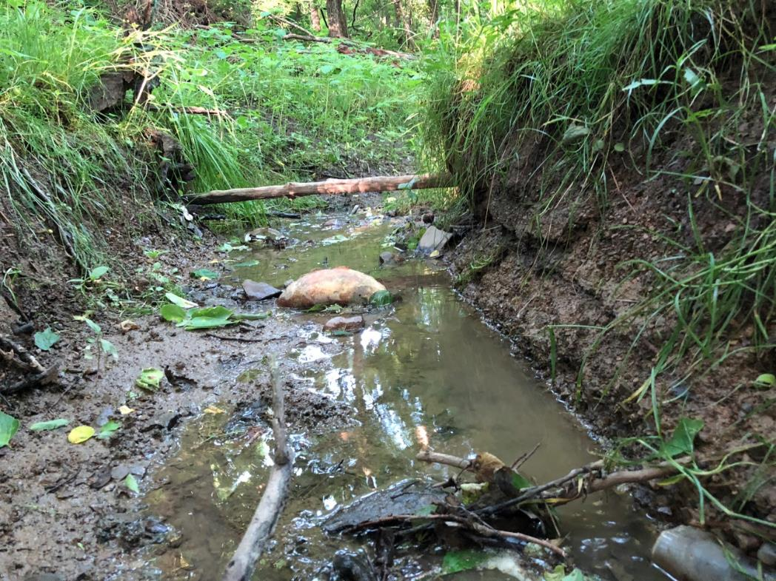
What Else?
Built Environments
Increase runoff rates
Increase runoff quantities
Increase pollutant discharges
Increases water temperature
Results In
Flooding
Erosion
Stream instability
Notes:
As shown on the slide water running over pavement moves faster than when it drains across grass or other vegetation. It picks up more dirt, debris and other pollutants; gets hotter; and doesn’t soak into the ground. That’s why the MS4 permit focuses on intensely developed areas.
When stormwater arrives at the stream, the water velocity or speed of runoff is faster than if it oozes out of the ground. The fast and concentrated water hits the stream banks like water from a firehose and causes the banks to erode and collapse. The end result is more sediment.
Some sediment is necessary and healthy. Too much of the fine sediment can coat and destroy aquatic habitat; Heavy coating of fine sediment kills the macroinvertebrates (or bugs, crustaceans and worms) which is the food supply for aquatic wildlife and so on, ultimately making the stream unhealthy.

Slide 10
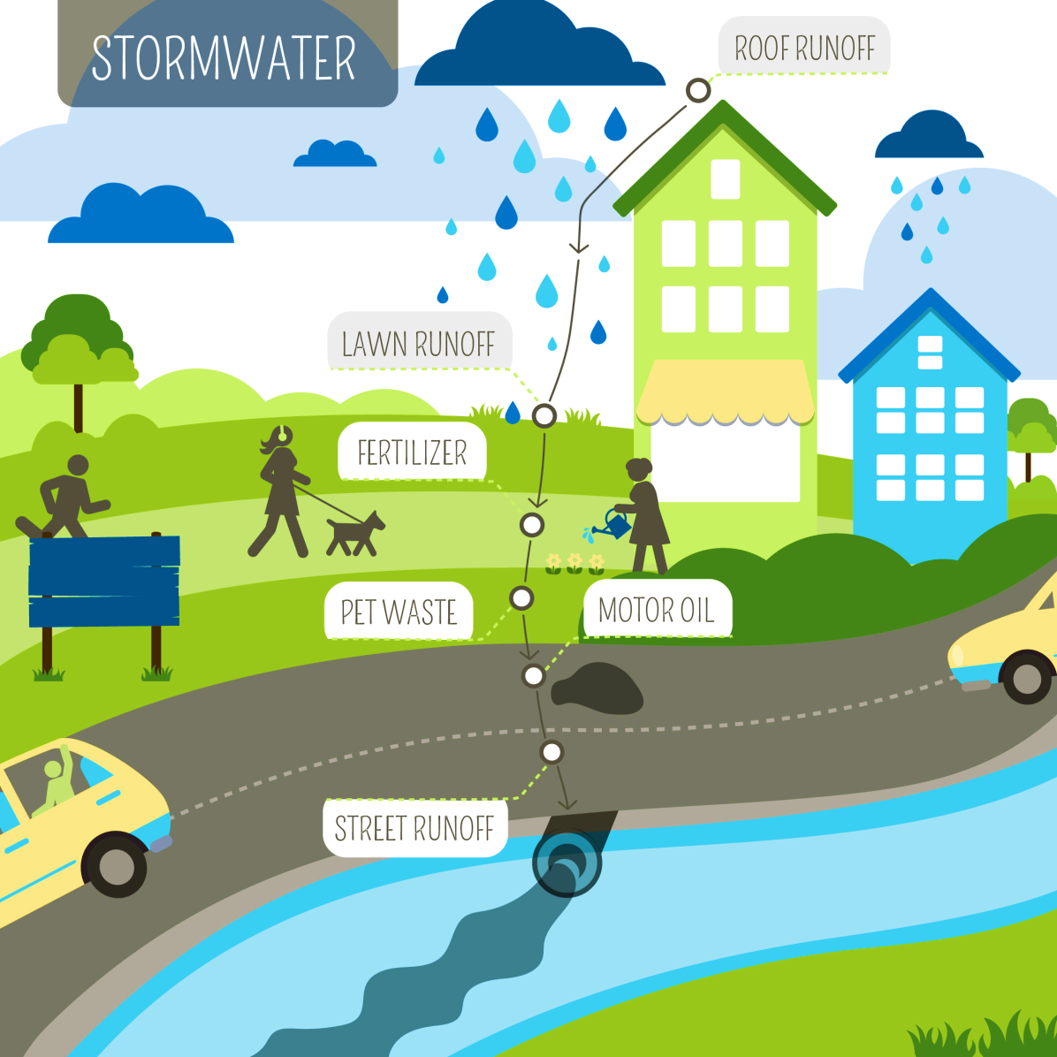
Where does Stormwater Runoff Go?
Stormwater runoff travels over the ground, and pavement
And through stormwater systems
  pipes, gutters, swales, and ditches
Transporting pollution
Discharges to:
Streams Rivers and Lakes
http://www.bunnellcity.us/infr-sw.aspx
Notes:
Where does stormwater go when it is captured in a stormwater inlet? The water and all the pollution are conveyed to area waterways untreated.

Slide 11
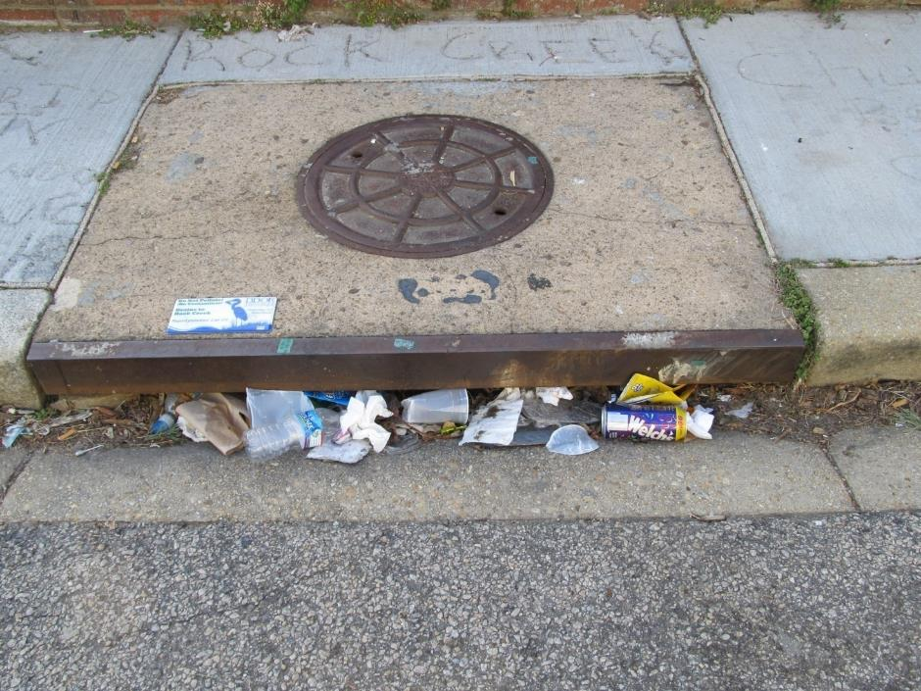
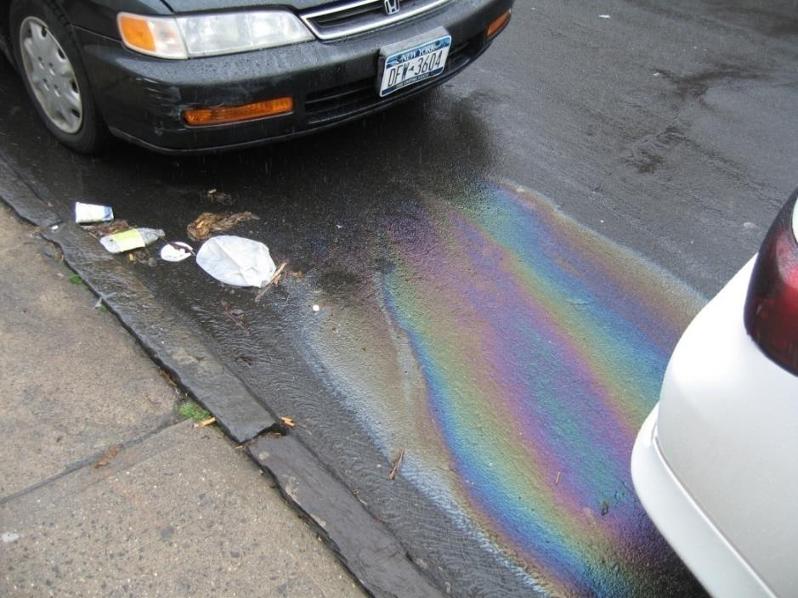
Runoff Transports Pollution
Trash and pollutants
in runoff
Trash/Litter
Automotive Fluids like Oil
Notes:
These pollutants are suspended and conveyed with the stormwater.

Slide 12
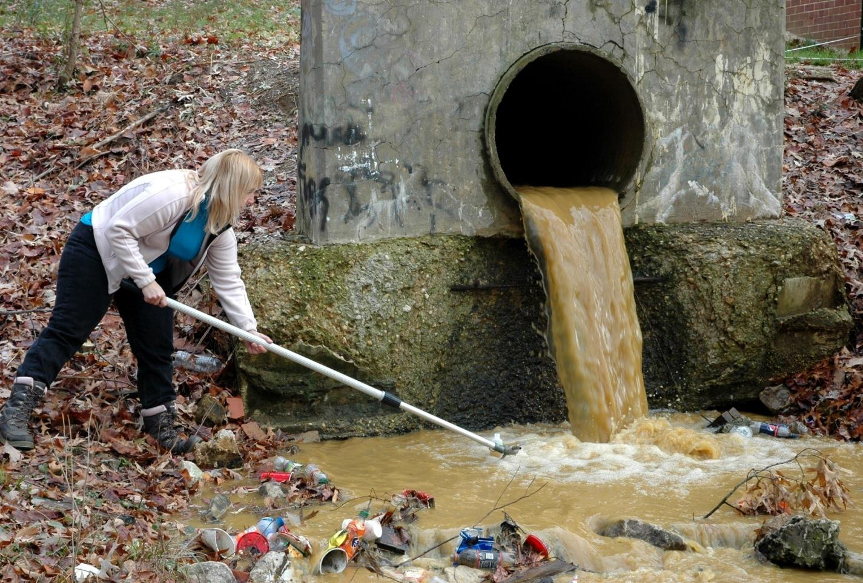
Sediment, pollutants and trash are
discharged from impervious surfaces
Notes:
Here is another example of water pollution.

Slide 13
MS4 Permit

Slide 14
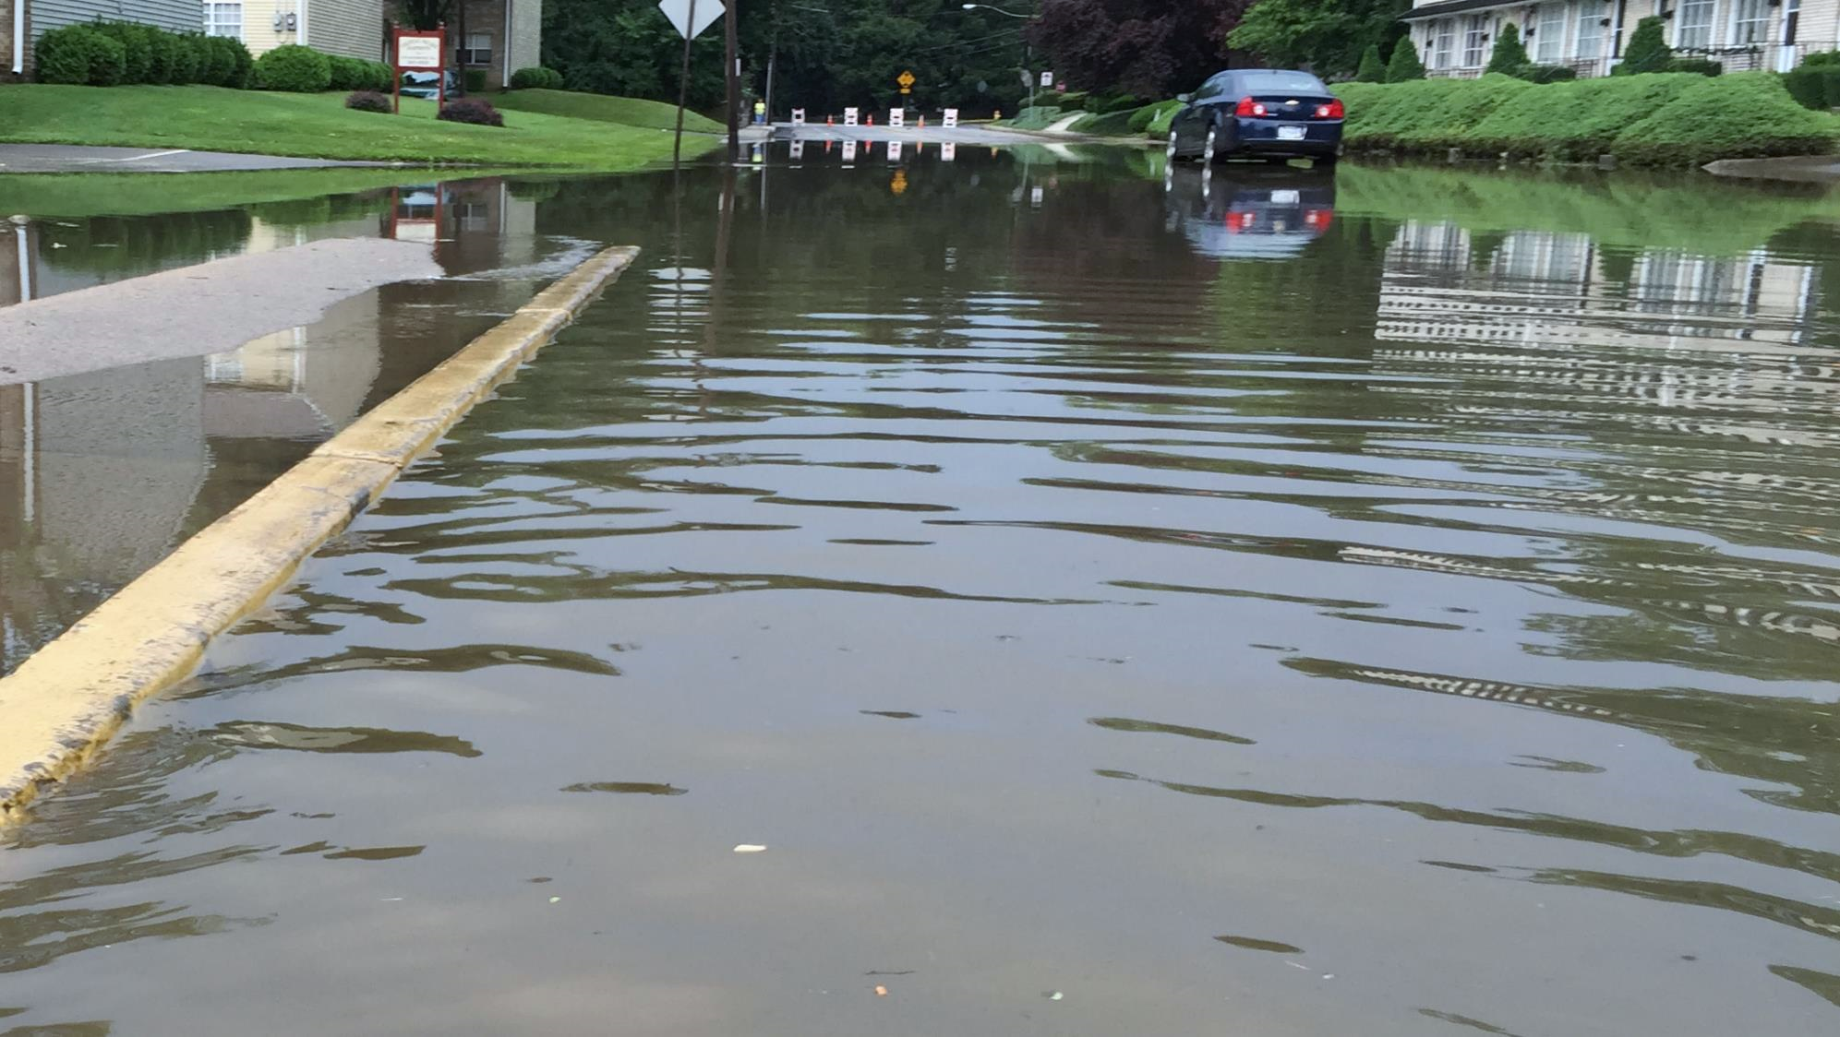
What is MS4?
Municipal
Separate Storm Sewer system
Notes:
It stands for the
One M and
Four S’s
At the beginning of each word.

Slide 15
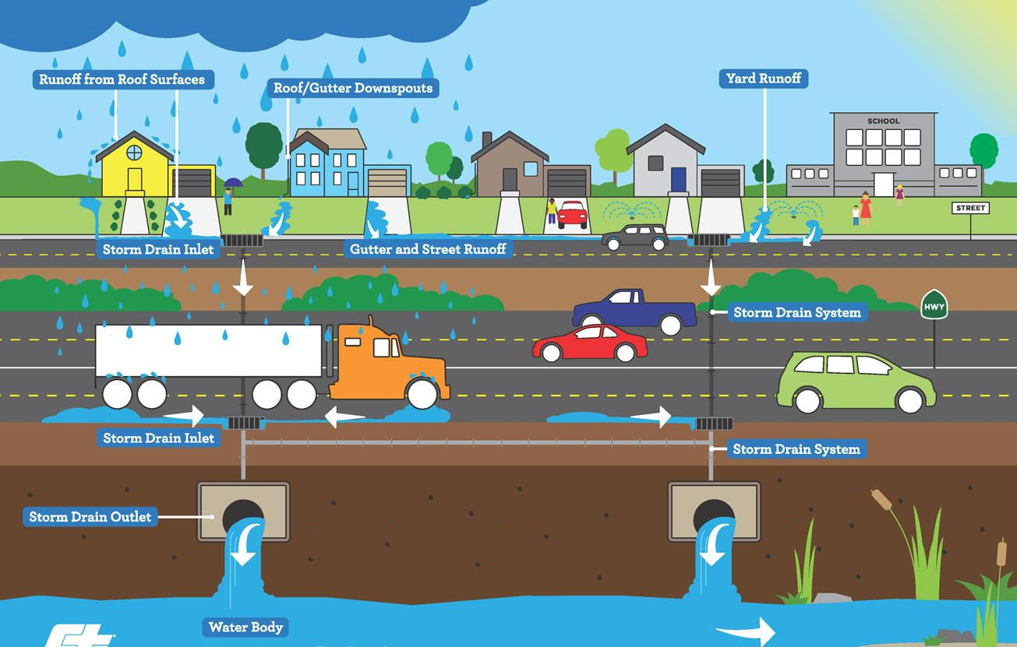
Separate Storm Sewer System
Swales & Ditches
Storm Drain Pipe
Roads & Highways
Storm Drain Pipe
Separate Storm Sewer System discharges runoff directly and carries pollution to water ways
Water Body
Notes:
The Separate Storm Sewer Systems is the collection of all structures that gather stormwater and discharge it into local waterways. The MS4 system includes (click) Inlets, (click) Curbs and Gutters, (click) Ditches and Swales, (click) Storm Pipes, (click) Storm Outlets and (click) Roads.

Slide 16
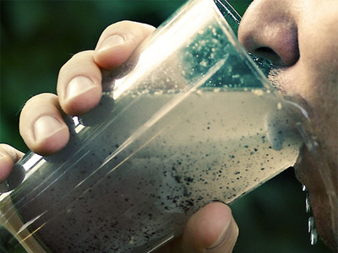
MS4 is all about
Clean Water
Storm Water
Urban Water
https://innovative-results.com/millions-in-u-s-drink-dirty-water/
Notes:
(Read slide)
MS4 focus is water QUALITY not flooding although flooding might be reduced as a result of water quality enhancement

Slide 17

MS4 Permit Components
Minimum Control Measures (MCMs) & Pollution Reduction Plan (PRP)
}
MCM#1 – Public Education and Outreach
Inform and Garner Support
MCM#2 – Public Involvement and Participation
}
MCM#3 – Illicit Discharge Detection and Elimination
MCM#4 – Construction Site Runoff Control
Reduce and Prevent Pollution
MCM#5 – Post-Construction Stormwater Management
MCM#6 – Pollution Prevention and Good Housekeeping
Pollutant Reduction Plan
Notes:
Middlesex’s Stormwater Management Program is a response to the MS4 permit.
Stormwater Management Program elements #1 through #6 are often referred to as Minimum Control Measures – MCMs. Item #7 is a more recent addition to the permit program and has not been designated as an MCM.
(Click) The first two MCMs are almost like a marketing plan…they are meant to educate , inform and inspire action to prevent or reduce pollution.
(Click) The other 4 MCMs are actions for prevention and the Pollution Reduction Plan is what it’s name says…a plan for installing treatment systems to reduce pollution.

Slide 18
MS4 Permit Components
Minimum Control Measures (MCMs) & Pollution Reduction Plan (PRP)
MCM#1 – Public Education and Outreach
Understand
Join/Support
Pollution
Escaping Mud
Functionality
Maintenance
Mitigation
MCM#2 – Public Involvement and Participation
MCM#3 – Illicit Discharge Detection and Elimination
MCM#4 – Construction Site Runoff Control
MCM#5 – Post-Construction Stormwater Management
MCM#6 – Pollution Prevention and Good Housekeeping
Pollutant Reduction Plan
Notes:
Each MCM has a particular focus:
(Click) #1 – Provides understanding of the negative effects of pollution in stormwater
(Click) #2 – Encourages joining the effort to reduce pollution
(Click) #3 – Identifies pollution sources so it can be removed
(Click) #4 – Focus on stopping migration of dirt from construction sites
(Click) #5 – Promotes long-term maintenance to ensure facilities continue to remove pollution
(Click) #6 – Advocates keeping Middlesex-owned and operated properties clean and tidy so they are not pollution sources
(Click) #7 – Provides a strategy to mitigate unavoidable pollution

Slide 19
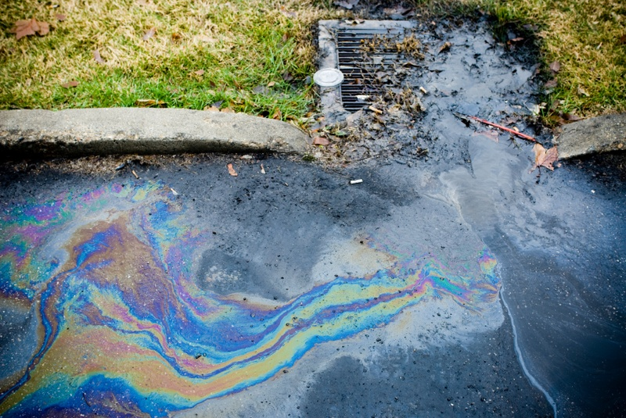
How Does Polluted Stormwater Happen?
As stormwater travels it picks up pollutants from…
  Lawns
  Parking lots
  Any other surface it crosses
Examples of pollutants
  Motor vehicle fluid
  Bacteria from pet waste
  Road salt
Pollution is transported directly into streams, rivers and lakes
https://fnfsr.org/harrisonburg-stormwater-utility-fee/
Notes:
As stormwater flows across surfaces, it lifts and suspends pollutants. Some examples include (Read slide). The stormwater also picks up other materials like sediment, fertilizers, pesticides, detergents and trash.

Slide 20
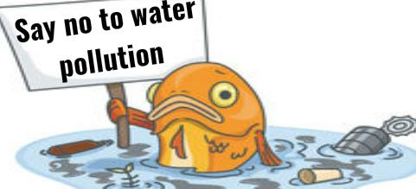
Why Should I Care?
Health Threat
  Polluted water is harmful to
    People
    Aquatic life
    Wildlife
    Plants
  It can kill or sicken fish, wildlife, and vegetation
  Contaminate our drinking water
  Cause people to get sick from eating fish or drinking water
https://www.clipart.email/clipart/how-to-prevent-water-pollution-clipart-4891.html
Notes:
These non-water ingredients don’t sound appetizing and they’re not. In fact they can be outright harmful to people, animals and wildlife. They can also cause degradation to the environment and habitat.

Slide 21
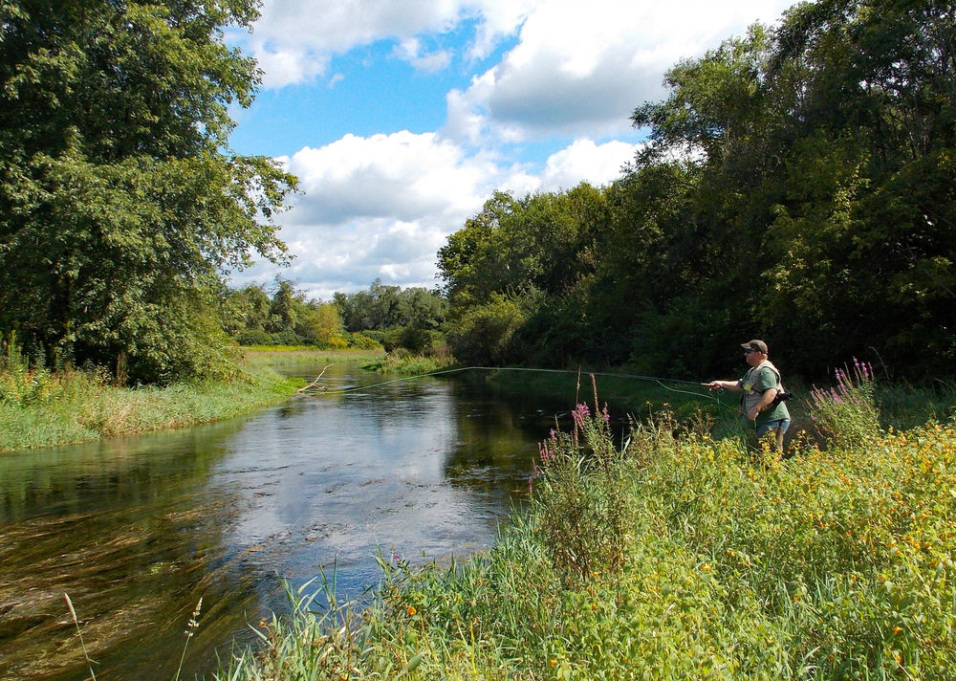
Why Should I Care?
Expense
  Preventing pollution is cheaper than removing the contaminates
Economic benefits
  Higher residential property values
  Protection of natural tourism and recreation industries
https://static.wixstatic.com/media/3494a1_ffc6825772544955a6e41bb30197a444~mv2_d_3209_2285_s_2.jpg/v1/fit/w_1000%2Ch_1000%2Cal_c%2Cq_80/file.png
Notes:
There are other reasons to care about the quality of our waterways. It is less expensive to prevent pollution from entering waterways than to remove it after it has spread. For example, consider an oil tanker spill in the ocean. It is cheaper to make sure the tanker doesn’t leak than to clean up afterward.
There are also economic benefits. In the Carlisle region, the Letort Spring Run, a nationally known Class A Trout stream, generates auxiliary businesses…tourism, fishing gear sales, and eateries serve the angler community. Likewise the adjacent trails attract hikers and bikers. And water is a people magnet. The natural beauty of the Condodoguinet and its tributaries like the Letort, attract residents to pay a premium to be within line of sight to the streams.
So protection of the waterways are economically and environmentally important.

Slide 22

What does it mean for you?
Documentation
Notes:
You all already do all the work required by this permit. However, like all permits, activity must be documented. In order for the Township to prove compliance the biggest change most of you will encounter is new documentation production, filing and retrieval.

Slide 23
Roles and Responsibilities

Slide 24

Middlesex MS4
Middlesex is responsible for maintaining storm water systems
  Comprehensive Stormwater Management Program (SWMP)
  Prevention and reduction of pollution in stormwater is essential to the SWMP
      Middlesex Employees are critical to Success
FROM WEB
https://2.bp.blogspot.com/-qnXizgpz27E/V5E1_0VbMdI/AAAAAAAABLE/D5ygT1iLrYMO_5yMVHjYrVEyFUaFHT4IwCLcB/s1600/2.png
Notes:
Middlesex is responsible for maintaining storm water systems
Challenges
Roads can convey polluted runoff
Stormwater systems convey pollutants
Solution
Management of the storm water systems
Develop/Implement comprehensive storm water program to reduce pollution during run-off events
Middlesex staff will play a critical role in educating the public, identifying pollution, preventing pollution and/or reducing pollution.
The next slides will explain how you can help the Township comply with minimum control measures 3, 4 ,5 and 6

Slide 25
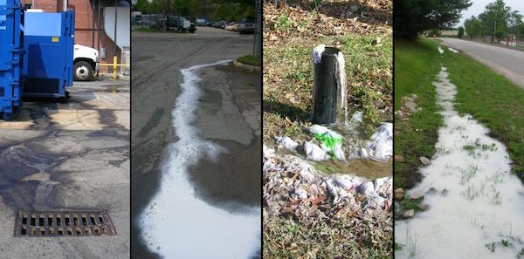
MCM#3
What is an Illicit Discharge?
In addition to pipes, swales and basins, Stormwater System includes the Roadway itself & Eroded Ditches!!!
Not Pure Stormwater
Notes:
An illicit discharge is any discharge to the Middlesex’s stormwater system that is not composed entirely of stormwater (click), except those discharges already authorized under the specific permits, which we will discuss later.

Slide 26
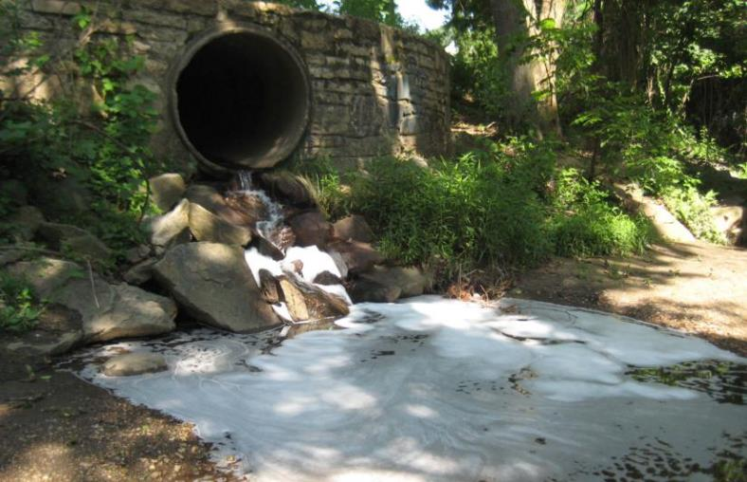
MCM3- Illicit Discharge Detection & Elimination (IDD&E) Overview
Develop, implement and enforce a program to detect and eliminate illicit discharges
Includes MS4 permitting area only
Middlesex Township program:
  outfall inspections
  illicit discharge reporting
  illicit discharge elimination
  documentation
Notes:
MS4 permit requirements include the development of an Illicit Discharge Detection and Elimination Program, often abbreviated as IDD&E. An outfall inspection is when an inspector goes to an outfall (location where the stormwater system enters a waterway, such as a stream) to determine the presence of an illicit discharge. Outfall inspections will be conducted twice during the five-year permit term. If you observe a potential illicit discharge, report it to your supervisor.

Slide 27
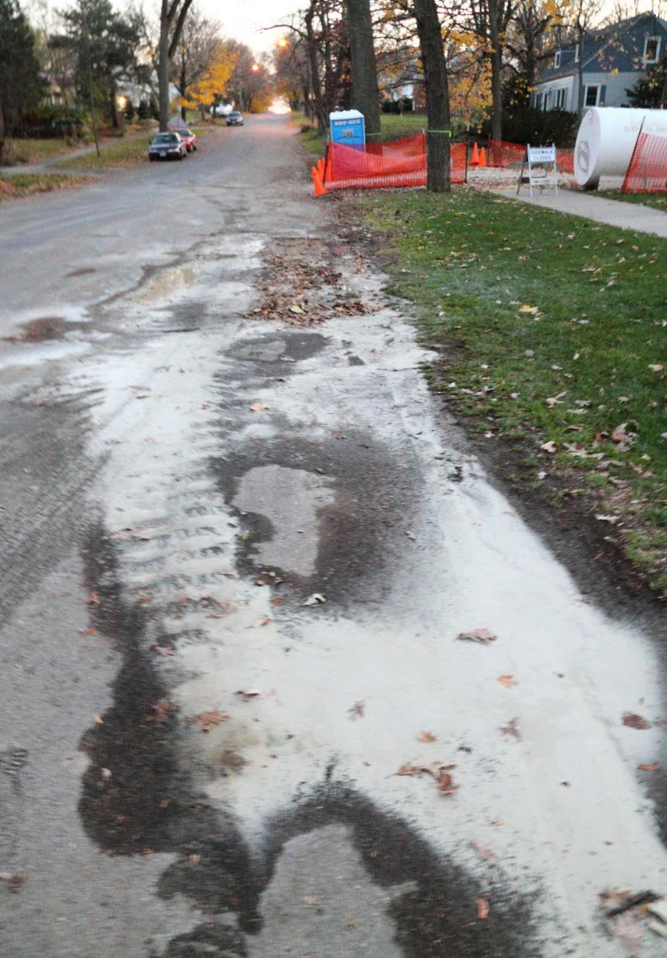
Discharges that ARE
Potential Illicit Discharges
Nonresidential Vehicle Wash Water
Accidental Spills (Hazardous and non-hazardous materials)
Direct Discharge of Agricultural Wastes
Cooking Oil and Grease
Sanitary wastewater from showers, sinks, etc.
Unauthorized Connections
Concrete Washout Water
Solid Waste Dumping
Sewer Discharges
Fertilizer, Pesticides and Herbicides – Misapplied or Over applied
Septic/Sanitary Sewer Discharges
Improper disposal of fluids (oil, gas, solvents, etc.)
Notes:
(Read Slide) These discharges are NOT acceptable and should be reported to your supervisor

Slide 28
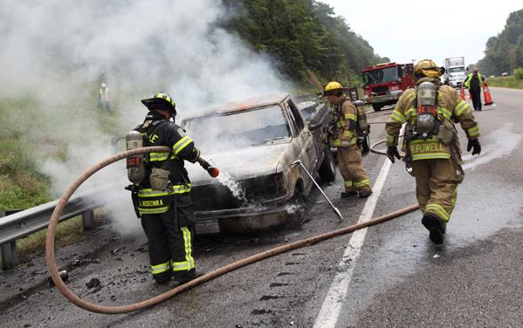
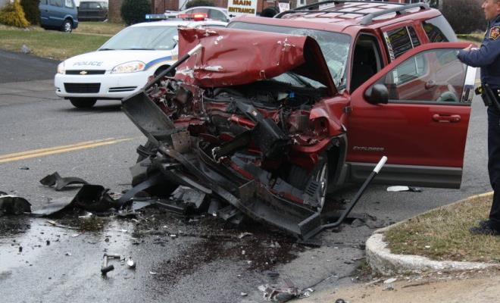
Discharges that are NOT
Potential Illicit Discharges
Fire-fighting activity
Accident Clean up
Potable water sources
Irrigation drainage
Lawn watering
Individual car washing
Building wash down (water only) Pavement washing (water only)
Air conditioner condensate
Riparian habitat/wetlands
Uncontaminated groundwater (springs, crawl space pumps, foundation/footing drains)
Waterline flushing
Notes:
These discharges are OK

Slide 29
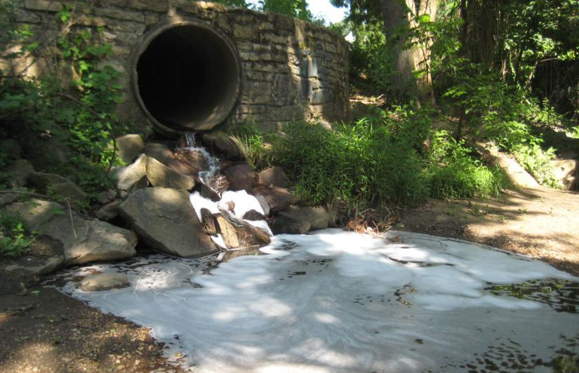
Identification of Potential Illicit Discharge
Potential Illicit Discharge Characteristics:
  Flow
  Odor
  Clarity/Turbidity
  Color
  Solids/Floatables
  Vegetation
  Deposits or Staining
Notes:
7 potential illicit discharge indicators are listed on the slide. These characteristics can be observed using our senses. No special equipment is needed, and no special testing is required. The seven indicators can predict an illicit discharge but need to be reported and investigated further.

Slide 30
Report Observed Potential Illicit Discharge to your supervisor
Potential Illicit Discharge Observed
During Middlesex Staff’s Routine Activity
Your Supervisor
Notes:
While Skelly and Loy will be performing the 1st-year outfall screening, if any of you observe discharge with these characteristics, report it to your supervisor. We are developing …you got it!...more forms and procedures for documentation. And that will be provided in upcoming sessions. For now, Rory Morrison, Barry Sherman and Eileen Gault will be responsible to resolve reported potential illicit discharges.
Let’s now discuss each of these indicators.

Slide 31
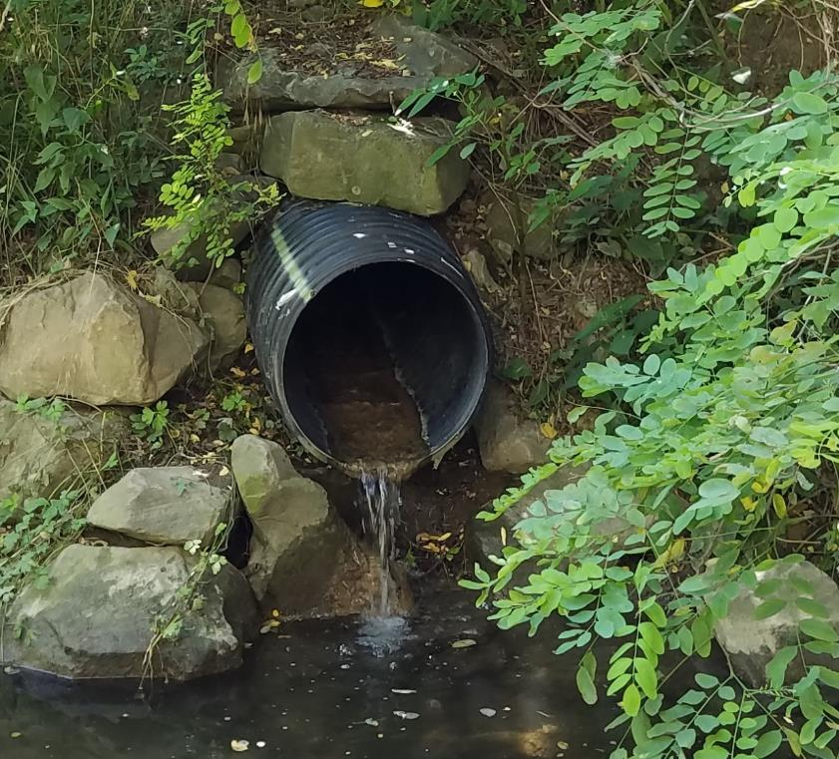
Identification of Potential Illicit Discharge
Flow – fluid discharge during dry weather.
Normal stormwater vs illicit discharge
  Has it rained in the past 3 days
    Yes → stormwater
    No → might be an illicit discharge
Report to your immediate supervisor
Flow
Notes:
Discharge from a storm water pipe during extended periods of dry weather (greater than 72 hours, 3 full days) should raise some alarm that it may not be stormwater. This may be an indication of a Potential Illicit Discharge and should be reported to your supervisor.

Slide 32


Identification of Potential Illicit Discharge
Odor - Musty, Sulfur, Rancid/Sour Milk, Sewage, Gas/ Petroleum, Cooking Oil.
  Is the discharge the SOURCE of the odor?
Under NO circumstance should Middlesex personnel intentionally smell an open source.
FROM WEB:
http://www.i2symbol.com/pictures/emojis/1/b/c/8/1bc851fb837a9caa815462a80c714a8e_256.png
Notes:
Establish what type of odor is being smelled. Is it musty, a sulfurous or sewage smell, or it similar to gas or petroleum? Try to determine the source of the odor to make sure the odor is coming from the potential illicit discharge. In some situations the source of the odor can be misleading; it may actually be shrubs, trash, carrion or animal waste. Never get too close to a strange discharge - they can be dangerous! Never inhale the air directly off an open source as many potential contaminants are harmful to nasal membranes and lung tissue.

Slide 33
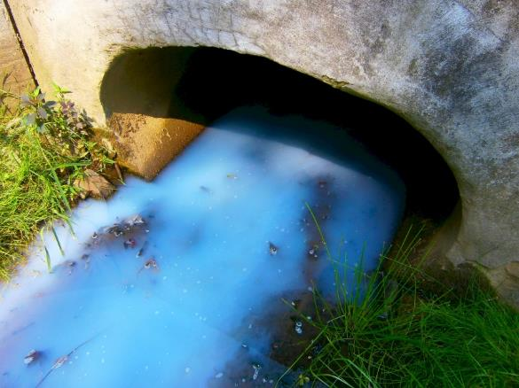
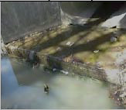
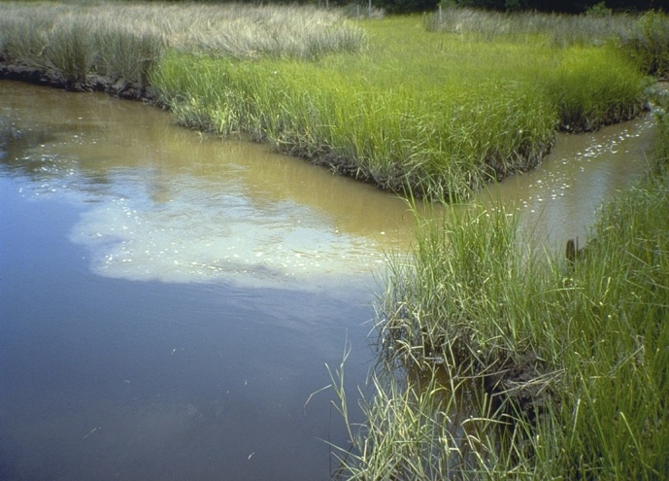
Identification of
Potential Illicit Discharge
Clarity/Turbidity
  Clear,
  Cloudy,
  Opaque,
  Grayness
If obvious, note Source:
  Spill, Accident, Dumping?
  Unauthorized connection?
  Eroding Streambanks?
Notes:
Continuing, Clarity/Turbidity is the next characteristic.
Turbidity is a measurement of the cloudiness of water, and it is caused by particles that are suspended in the water.
Clarity gives us an idea how far light can penetrate into the water.
Characteristics of these two include:
Clear, Cloudy, Opaque, and Grayness.
Is the water murky? If so, a Potential Illicit Discharge may be present. If obvious, note the source.

Slide 34
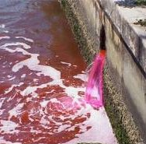
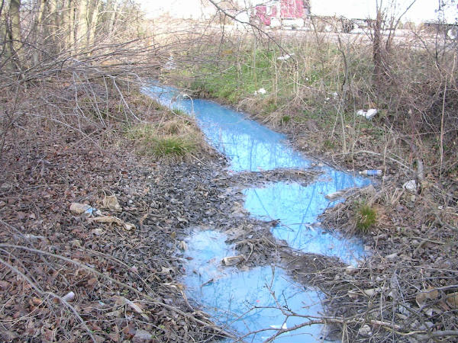
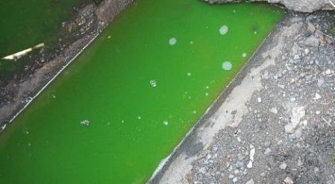
Identification of
Potential Illicit Discharge
Color –
  Clear,
  Slightly Tinted,
  Visible Colorations (e.g. Red, Green, Blue, other).
Note: Water depth, substrate composition, aquatic plants, and sky conditions can all influence your perception of the color of water.
Notes:
Unnatural color of water can also indicate an illicit discharge. Do not try to assess the color of water by looking directly into the waterway. Water depth, substrate composition, aquatic plants, and sky conditions can all influence your perception of color.
But certainly the obvious, such as that shown in the pictures on the right, can be easily identified.

Slide 35
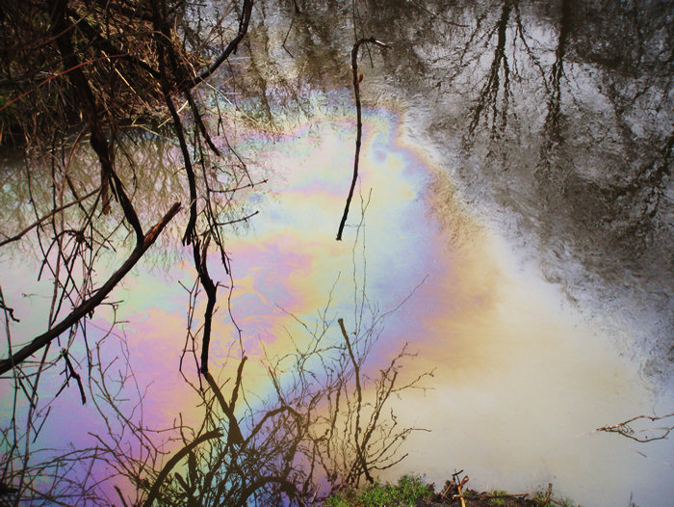
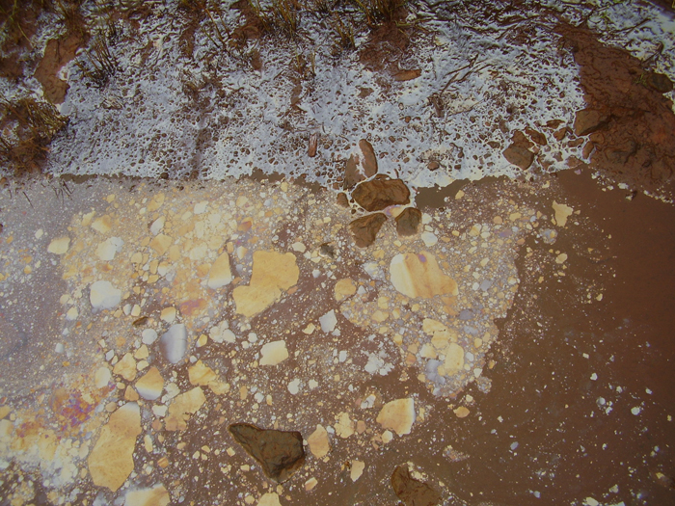
Identification of Potential Illicit Discharge
Solids/Floatables Garbage, Sewage, Oily Sheens, or Suds
Smooth Cohesive Swirls
Individual Clumps
Petroleum Sheen – swirls and re-adheres if mixed
Nonpetroleum Sheen – breaks apart into clumps with jagged edges
Notes:
Solids and floatables in a water stream or body is also a sign of a Potential Illicit Discharge. A visual observation can usually be seen from a distance making it more noticeable than other indicators. This may include Garbage, Sewage, Oily Sheens, or Suds.
Both pictures show examples of an oily sheen. Such a condition can be natural and not indicative of petroleum. You can use a stick to stir the water to determine whether it’s a naturally occurring sheen or petroleum-based sheen. Petroleum sheens will swirl and re-adhere quickly while naturally occurring sheens will separate into clumps with jagged edges.

Slide 36
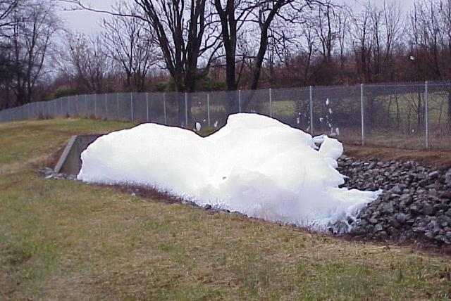
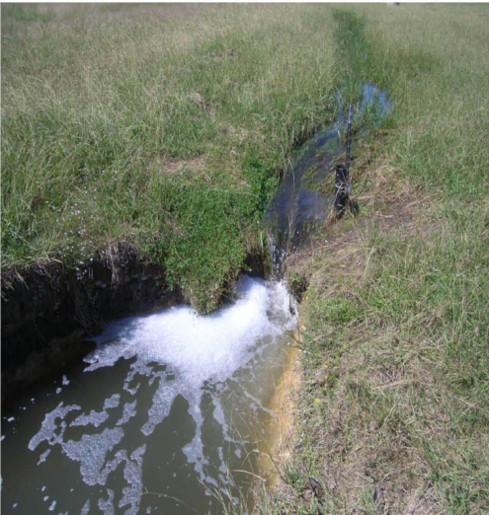
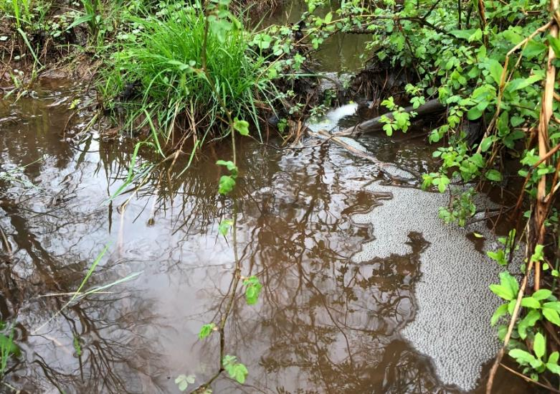
Identification of Potential Illicit Discharge
Solids/Floatables
Manmade foam/suds is usually white in color and sometimes has a sweet or scented odor.
Natural Foam/Suds may appear white at first but will generally turn brown over time
Notes:
Foam or suds can also be either natural or manmade. Naturally occurring suds will break up quickly and are generally clear or white but will turn brown over time. Manmade foam or suds are white and can have a sweet or scented odor. Naturally occurring floatables should NOT be reported as potentially illicit.

Slide 37
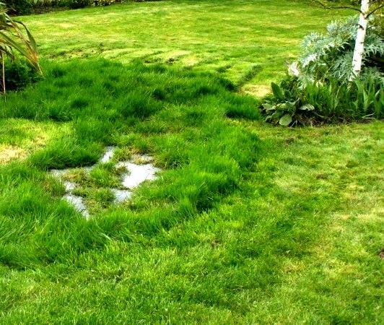
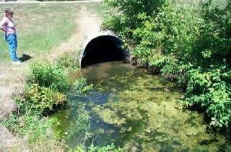
Identification of
Potential Illicit Discharge
Septic System Failure
Vegetation -
  Excessive growth
  Algae plumes
  Stressed
  Damaged
  Dead
FROM WEB: https://www.nylundinc.com/septic-tank-failure-Vancouver-washington/clark-county-wa
Algae
FROM WEB: https://dnr.mo.gov/env/swcp/nps/images/slideshow/algal-bloom.jpg
Notes:
Vegetation can also indicate an illicit discharge. Some pollutants may kill vegetation while others may promote excessive growth of algae or other vegetation.

Slide 38
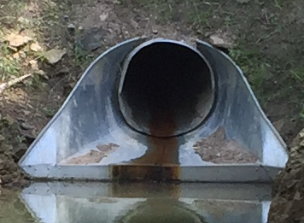
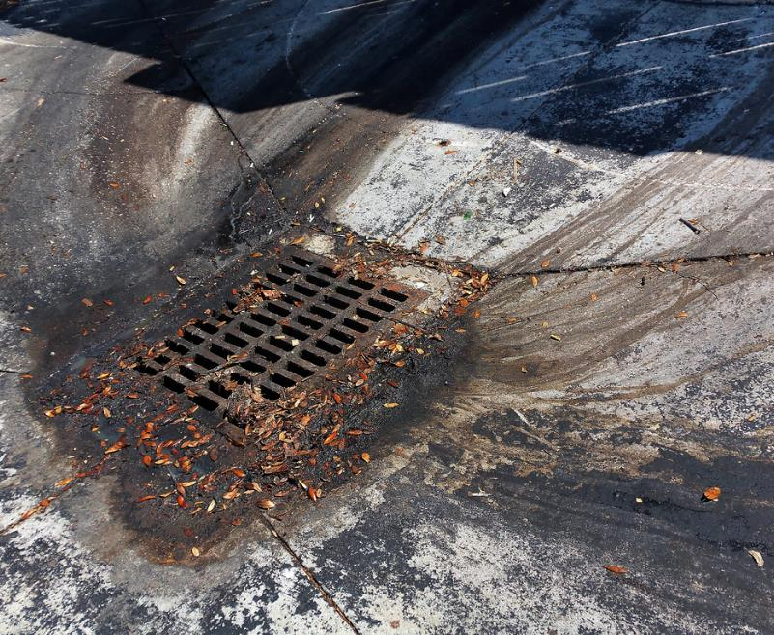
Identification of
Potential Illicit Discharge
Brown Stain @ invert
Swept material?
Staining- Color, Sheen, Material Fragments
Notes:
Illicit discharge may cause staining. Sewage may be present if there is black staining inside the drainage pipe; visible evidence of sanitary waste, such as toilet paper or opaque or gray water. Certainly, there also may be an odor.
Do not report a rusty pipe as a Potential Illicit discharge! Do report it if there is an indication that something else caused premature rust or that the rust originated from upstream.

Slide 39
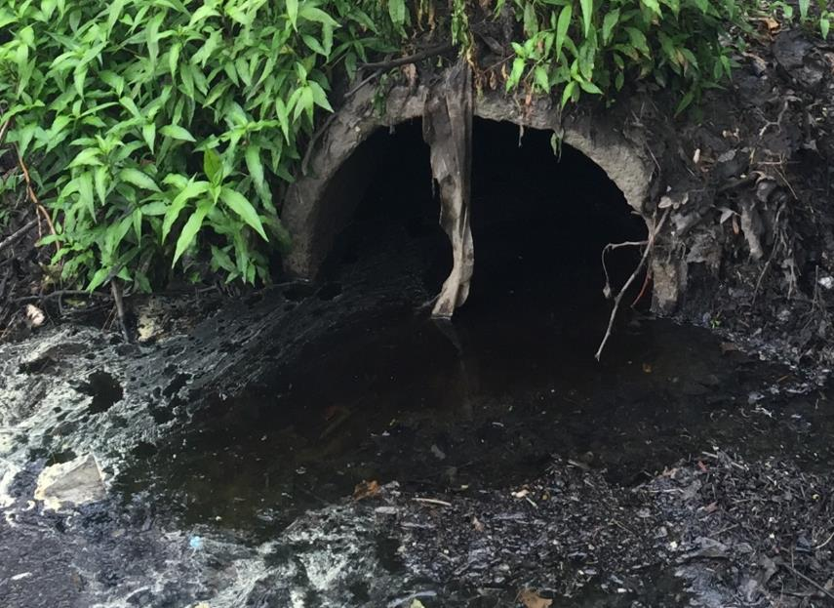
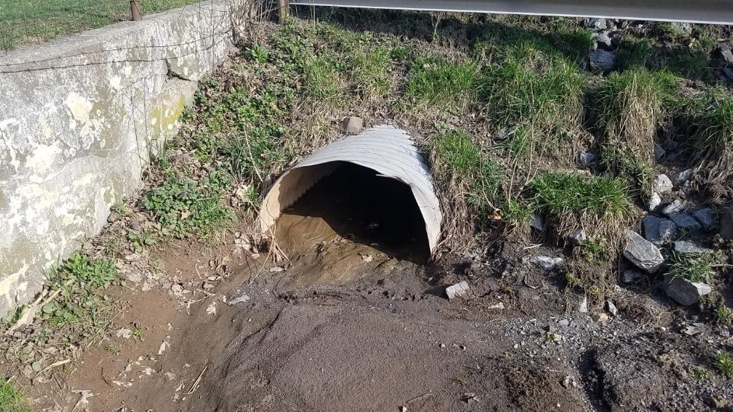
Identification of
Potential Illicit Discharge
Oily Substance
Deposits
  Minerals,
  Sediments,
  Oils,
  or Grease.
Sediment Deposit
Notes:
Deposits are sometimes indicators too. For example, gray-white deposits can be from illegal dumping of concrete truck washouts and crystalline powder can indicate the discharge of fertilizer wastes.

Slide 40

MCM#3 Summary
You are our eyes.
Report suspicious looking water to your supervisor.

Slide 41
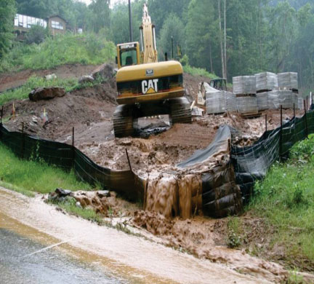
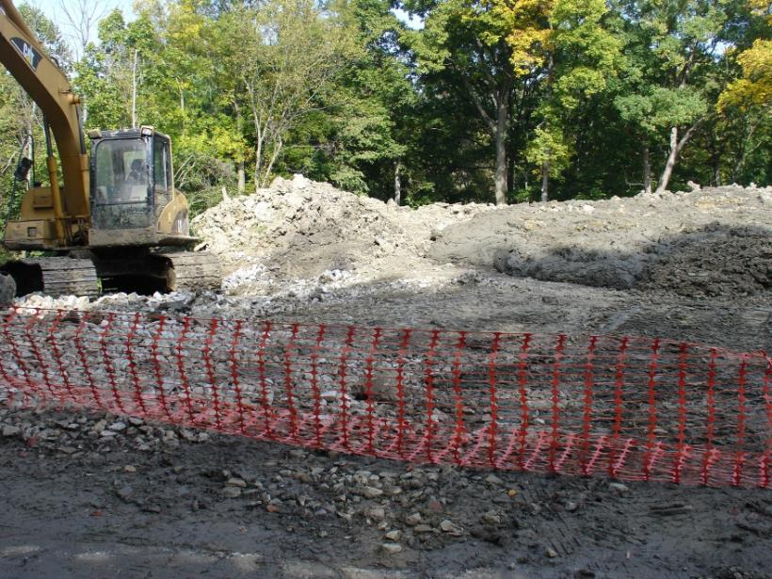
MCM #4:
Construction Site Runoff
Goal: Prevent pollutants from reaching waterways during earth disturbance activity.
Priority is erosion and sedimentation (E&S) control
  Coordinate with
    Cumberland County
    Conservation District
  Inspections
  Enforcement
  Training
http://www.bluewaterbaltimore.org/the-waterkeeper/programs/stormwater-pollution/
Notes:
Middlesex largely relies on the County Conservation district and the Township Engineer, Bud Grove (Skelly and Loy) to monitor discharges from construction sites.

Slide 42
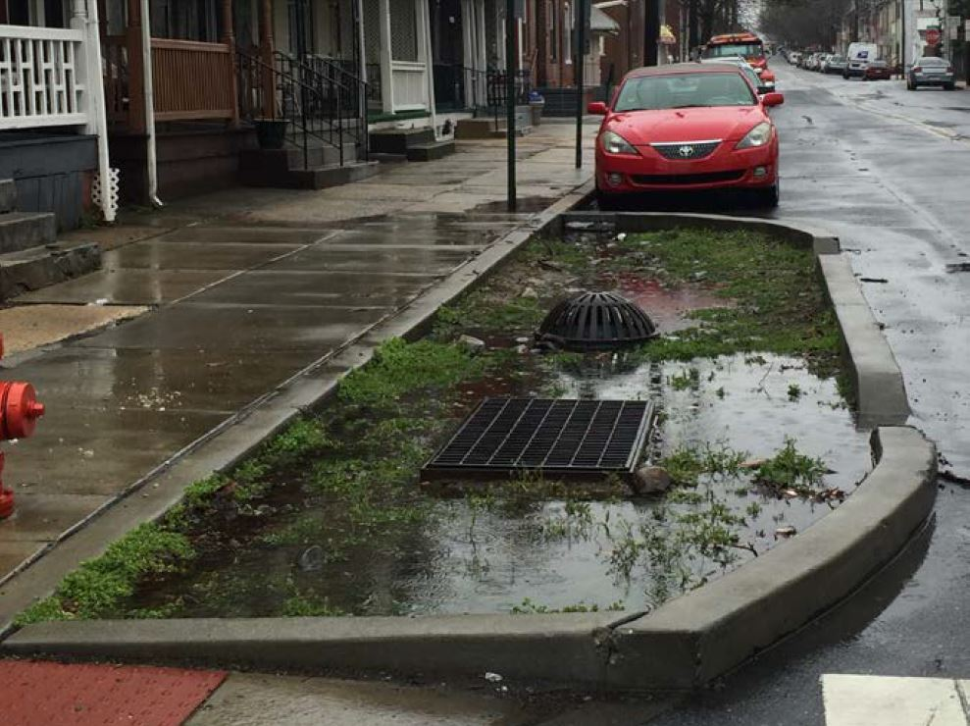
MCM#5
Post Construction Stormwater Management (PCSM)
Goal: Ensure stormwater management facilities are functioning and maintained
  Stormwater Management Ordinance
  Standard Operating Procedures (SOPs)
  Inspections
  Deficiency correction
Sediment clogging:
This media will have to be dug
out, disposed of, and replaced
WEB
Notes:
The Township will be intensifying monitoring the functionality of Stormwater Management facilities.
Maintenance is required to make sure facilities perform as designed.
(Click) The Township, homeowners’ Associations, or private land owners are responsible to operate and maintain stormwater facilities. It depends on who constructed the facilities and who accepted ongoing maintenance responsibility.
Currently, the Township relies on the County Conservation District, the Township Engineer, and Mark Carpenter for enforcement. But all of you are front line scouts. Report stormwater facilities that don’t look right to your supervisor.

Slide 43
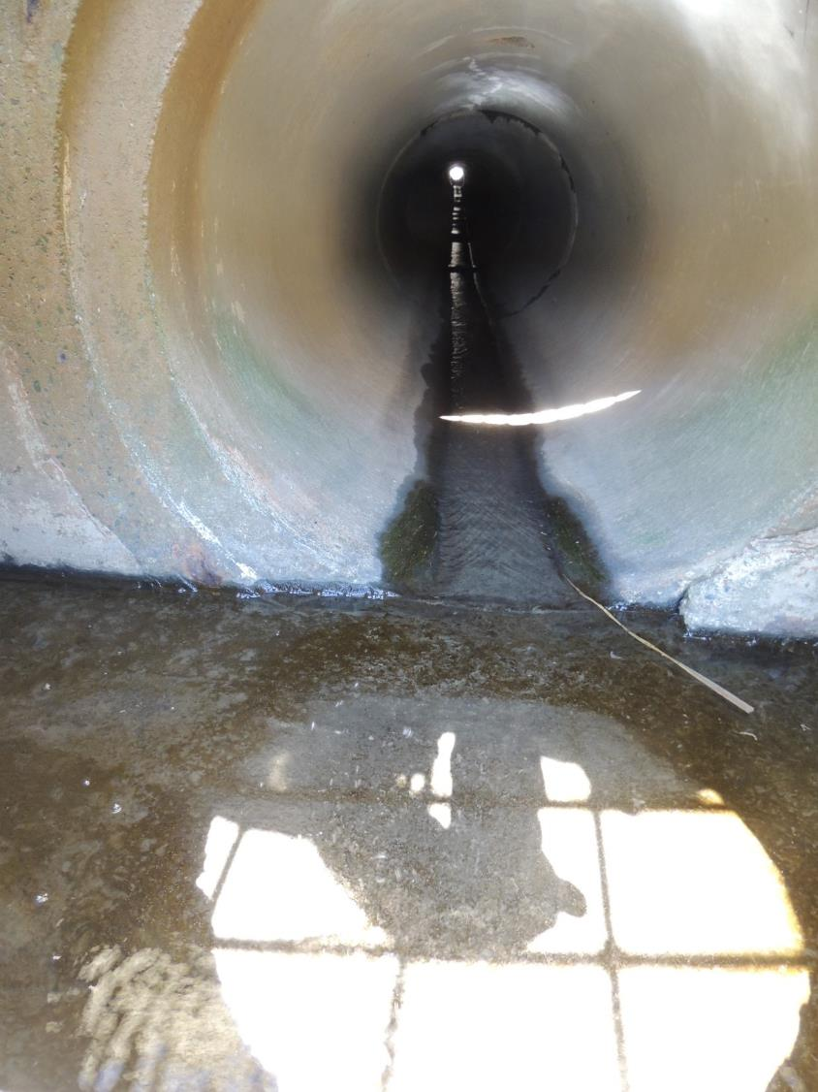
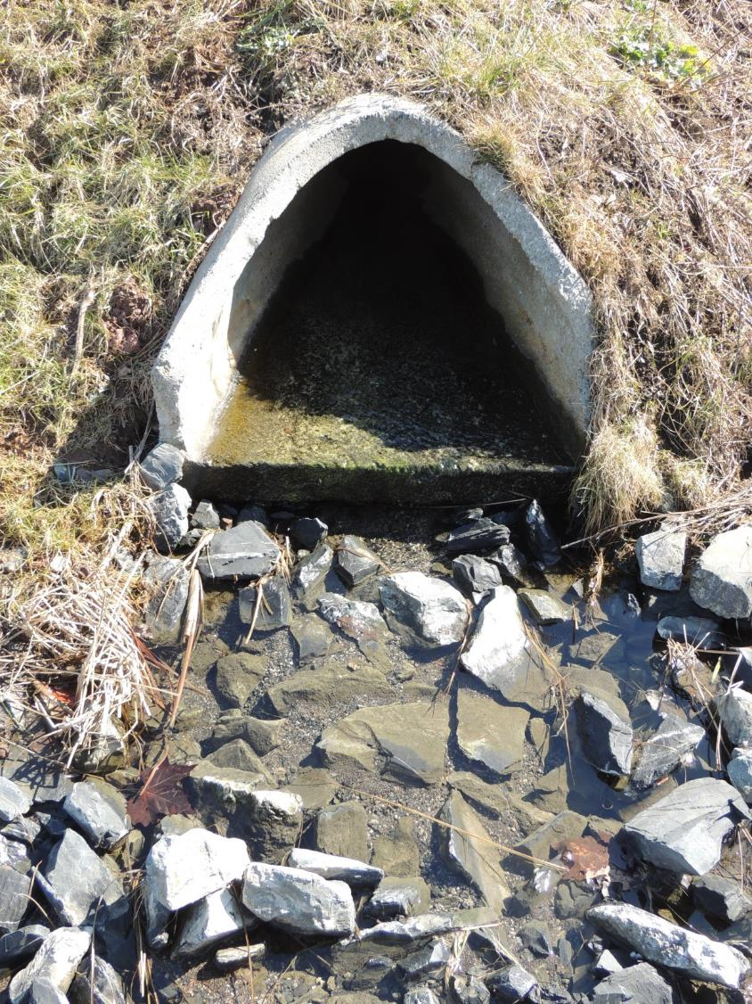
Pipe is intact and free of sediment and debris
Rip-Rap apron is in place with no signs of erosion or displacement
Notes:
These are examples of functional stormwater facilities

Slide 44
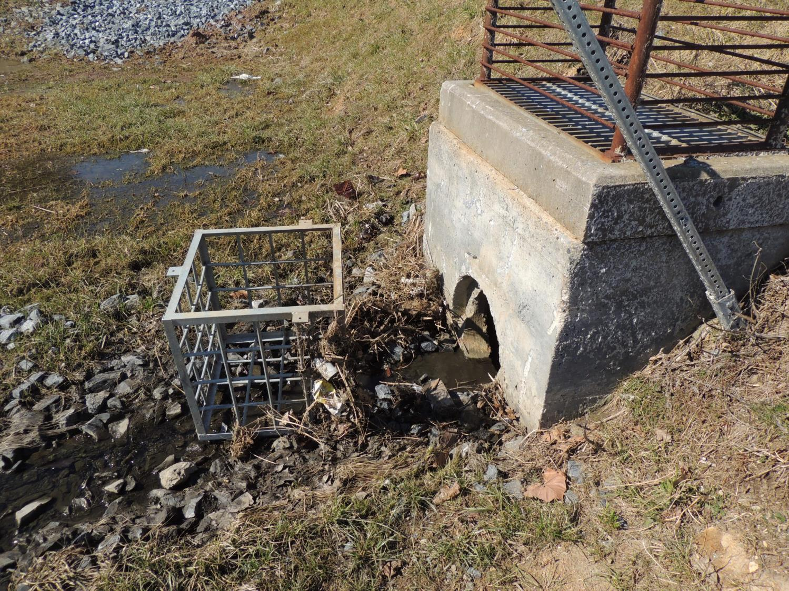

Trash rack is detached and needs to be reattached
Notes:
Here is a facility that needs repair.

Slide 45

MCM#6:
Good Housekeeping and Pollution Prevention
Anderson Park Standard Operating Procedure
Notes:
MCM#6 focuses on the Township’s operations and procedures to prevent and reduce pollution emanating from Township-owned property exclusive of streets and roads.

Slide 46

Middlesex Township
Urbanized Area
You are here
Notes:
Remember at the beginning we said MS4 is all about Clean Water, Stormwater, Urban Water? The Urbanized areas regulated by the MS4 permit are delineated by the US Census Bureau in the latest 10-year Census. The designation is largely based on population density, but the US Census Bureau has incorporated a couple other criteria related to impervious surface.

Slide 47

Middlesex Township
Urbanized Area
You are here
Urbanized Area
Notes:
In Middlesex, the Urbanized Area (highlighted in pink on the slide) surrounds the Miracle Mile where the trucking operations and warehousing are generally located.

Slide 48

Middlesex Township
MS4
Area
You are here
Anderson Park
Yellow Hatch Area is Contributing Drainage and expands the Regulated MS4 Area
 | Urbanized Area
+ | Contributory Drainage
 | Regulated MS4
Notes:
The regulated area also includes adjacent land that flows into the urban area before reaching a stream, shown in yellow. Anderson Park is the only Township-owned property that is in the regulated MS4.

Slide 49


Good Housekeeping Activities
Manage litter
Collect pet waste
Close refuse and recycling container lids
Manage Vegetation;
  Mowing
  Leaf and Debris Clean up
Notes:
Anderson Park is the only site that is REGULATED. However, the Township wants all Township-owned properties to be kept ship-shape and clean, including the Township building with its maintenance and police operations.
So what does the SOP, say to Middlesex Maintenance Crew?
Barry, as the Roadway Supervisor, has the responsibility to make sure you do the jobs listed on the slide.
The SOP lists the MINIMUM frequency for completion of jobs
Examples:
Collect and deposit trash and pet waste in trash bins 1x month…year round
Mowing 1x week…during the growing season
Leaf collection 2x in November
Trimming Trees and pick up debris, as needed
It provides other direction. For example, when you mow, you will direct clippings away from stormwater conveyance. So that means don’t put clippings in gutters or inlets. If you do…you will need to sweep up, collect and dispose of the clippings because clippings are not pure water so they are considered a pollutant. And of course they can cause other problems too, like blocking inlets and causing ponding water on roadways.
The SOP states that refuse will be emptied and disposed by a certified refuse hauler.

Slide 50
Middlesex Achievements

Slide 51

2018 to 2019 Achievements
Approved MS4 Permit
Funded projects include:
Open Vegetated Roadside Channels (8,900 LF at 7 sites)
Rain Garden at Andersen Park
Stream Restoration for Unnamed Tributary to Wertz Run (1,100 LF)
Began development of the Township Stormwater Management Program (SWMP)
Mariner Grant- $631,600
Notes:
The Township is required to perform activities to prevent/reduce pollutants including more vigorous attention to maintenance, replacement of degrading infrastructure, plus new pollutant reducing project. All of this is very expensive.
The Township was successful in a grant award to fund the Pollutant Reduction Plan Projects or PRPs.

Slide 52

Green Stormwater Infrastructure (GSI)
Grey infrastructure
Grey infrastructure
Notes:
Before we walk through the Township’s PRP projects, let’s understand just a little bit how they work.
Many PRP Projects rely on reducing pollutants by promoting infiltration into the soil. The soil acts like a filter by capturing pollutants. Infiltration also slows the velocity and amount of stormwater runoff and reduces erosion.
(Click) Infiltrative stormwater management solutions are collectively called “Green” or Green Stormwater Infrastructure, abbreviated GSI.
(Click) Traditional inlets and pipes are called grey infrastructure.

Slide 53


Proposed PRP Projects
Open Vegetated Channels
Various Locations
Check Dam (typ.)
Before
After
Notes:
First up… Open Vegetated channels.
There are 7 proposed vegetated roadside channel projects. Open vegetated channels can be effective pollutant reducers by simply by maintaining road shoulder stability. In other words, conveying storm water without causing erosion. The channels are under evaluation to determine the appropriate solution at each site. As shown in the pictures, check dams are one option under consideration to reduce pollutants. Another option under consideration includes a subsurface stone bed to enhance infiltration. Some solutions might mix green and grey infrastructure.

Slide 54

Proposed PRP Projects
Treatment Train
Appalachian Drive
Open Vegetated Channel
+ Plunge Pool
Greater Reduction
Notes:
Appalachian Drive has some site constraints, but the Township is going to maximize pollutant reduction using a treatment train, which means the construction of two or more pollutant reducing management solutions that are interconnected. More pollutants are removed as the water moves along the system than would happen if there were only a single treatment.
The area along Appalachian Drive drains runoff from a hillside to the east side of the road. There is limited road shoulder. The terrain drops steeply toward an adjacent agricultural field and the bank is eroded. The runoff then concentrates in a dip and continues across the field.
The plan here includes installation of an open vegetated channel with a plunge pool located in that dip. The plunge pool will dissipate the energy of the runoff. The temporary impoundment promotes settlement of sediment and slows the runoff to allow for infiltration to scrub pollutants.

Slide 55


Proposed PRP Projects
Rain Garden
Anderson Park
Before
After
Notes:
We spoke of Anderson Park in MCM#6 and the Township proposes a raingarden at this location.
The rain garden will add visual interest to the park and will act as a sponge to reduce runoff onto the road. In addition, the plants will utilize the nutrients, which are considered to be pollutants, for growth. The project is valuable due to its high visibility and prominent position in the park that will make it attractive for promotion of the MS4 program and a natural education site.

Slide 56

Proposed PRP Projects
Stream Restoration/
Stabilization Project
Northwest of Wolf’s Bridge
and
West Middlesex Roads
Notes:
The Township will be undertaking a Stream restoration/ stabilization project on the Frey Phillips Property located Northwest of Wolf’s Bridge and West Middlesex Roads.
We talked about the negative impacts to stream health caused by erosion previously in the presentation. What we didn’t discuss yet is that stream bank erosion is THE largest contributor of sediment to our waterways so stabilizing banks and providing area for floodwater to spread out and slow down is THE MOST EFFICIENT PRP for sediment reduction.

Slide 57


Proposed PRP Projects
Stream Restoration/
Stabilization Project
Debris Dam
Buried Bottle
Notes:
The pictures show what the stream looks like right now. The ravine is 4 to more than 8-feet deep and highly eroded.
Left: An old glass bottle (arrow) freshly exhumed by erosion from the legacy sediment veneering the floor of this little valley. Note the plant roots with the soil still attached to them, a sure sign of active bank erosion.
Right: Debris dams retaining large quantities of fine sediment are ubiquitous along the stream. The little debris dam at the arrow is retaining more than one-half cubic yard of freshly eroded sediment.

Slide 58


Proposed PRP Projects
Stream Restoration/
Stabilization Project
Notes:
The plan is to construct a step-pool channel and use rock to dissipate the stream’s erosive energy and stabilize it.
Left: concept channel cross section view of a boulder weir
Right: Concept profile view of a constructed step-pool stream channel

Slide 59



Proposed PRP Projects
Stream Restoration/
Stabilization Project
Notes:
This is a series of pictures to help you visualize what it will look like in the future.
Photo 1: Similar sized project in Philadelphia (click)
Photo 2: After Construction(click)
Photo 3: A stream in northwestern PA shortly after the project completion...Larger than the tributary that will be restored…flow in the Middlesex channel will likely be visible in only in wet years and during significant rain events

Slide 60
Middlesex MS4 Summary
Acronyms
E&S: Erosion and Sedimentation
GSI: Green Stormwater Infrastructure
IDD&E: Illicit Discharge Detection and Elimination
MCM: Minimum Control Measure
MS4: Municipal Separate Storm Sewer System
PCSM: Post Construction Stormwater Management
PRP: Pollutant Reduction Plan
SWMP: Stormwater Management Program
Notes:
Here is a list of the acronyms we used in the presentation.
(Click) The one you need to remember is MS4.
The others were provide so you become familiar with them… Eventually you too will want to abbreviate some of these long descriptions.
Alphabetical Acronym List
E&S Erosion and Sedimentation
GSI Green Stormwater Infrastructure
IDD&E Illicit Discharge Detection and Elimination
MCM Minimum Control Measure
MS4 Municipal Separate Storm Sewer System
PCSM Post Construction Stormwater Management
PRP Pollutant Reduction Plan
SWMP Stormwater Management Program

Slide 61

Middlesex MS4 Summary
Pollution Prevention
No Illicit Discharges
Control Construction E&S
Keep Township Properties Clean
Prevent/Clean-up spills and leaks
Pollution Reduction
Construct Projects
Functional Stormwater Management Systems
Notes:
Pollution Prevention
Eliminating intentional or accidental releases of hazardous materials into the stormwater system that feeds the streams
Preventing loose soil from leaving construction sites
Ensuring stormwater management facilities designed to slow run-off or remove water pollution are functioning well
Keeping Township properties clean
Preventing pollution releases during Township’s operation and maintenance activities
Pollution Reduction
Constructing projects to reduce pollution

Slide 62
Next Steps

Slide 63
Dry-weather screenings of outfalls (1st cycle: Consultant /2nd cycle: Middlesex Staff)
Notes:
The screenings are planned for early November

Slide 64
Dry-weather screenings of outfalls (1st cycle: Consultant /2nd cycle: Middlesex Staff)
Updated to portable data collectors
Notes:
The data collectors always need to have current versions of software and then it needs to be tested to see the update causes any unexpected problems. The data collectors have been updated and are ready to go!

Slide 65
Dry-weather screenings of outfalls (1st cycle: Consultant /2nd cycle: Middlesex Staff)
Updated to portable data collectors
Enhancement of Mapping
Notes:
Mapping is being updated now. Revisions to locations of pipes and swales and new information is regularly being incorporated

Slide 66
Dry-weather screenings of outfalls (1st cycle: Consultant /2nd cycle: Middlesex Staff)
Updated to portable data collectors
Enhancement of Mapping
Creation of chain of command and reporting processes
Notes:
We will be creating better reporting of suspicious discharge and other stormwater related issues and a chain of command so staff knows who to report to for resolving problems.

Slide 67
Dry-weather screenings of outfalls (1st cycle: Consultant /2nd cycle: Middlesex Staff)
Updated to portable data collectors
Enhancement of Mapping
Creation of chain of command and reporting processes
Creation and initiation of forms and instructions for many forms of documentation
  Tracking complaints
  Tracking potential illicit discharges
  Documenting erosion control during construction
  Documenting long-term operations and maintenance of stormwater management controls
Notes:
You will be seeing more types of forms for documentation

Slide 68
Dry-weather screenings of outfalls (1st cycle: Consultant /2nd cycle: Middlesex Staff)
Updated to portable data collectors
Enhancement of Mapping
Creation of chain of command and reporting processes
Creation and initiation of forms and instructions for many forms of documentation
  Tracking complaints
  Tracking potential illicit discharges
  Documenting erosion control during construction
  Documenting long-term operations and maintenance of stormwater management controls
Many More…

Slide 69
Questions

Slide 70
Me first…
What do you know?
What is Stormwater?
What is stormwater runoff?
Where does runoff go?
What does the acronym MS4 represent?
What is the MS4 Permit…Why is it needed?
How does the permit involve you?
Notes:
Let’s check what you know now?
Have Eileen count hands for each question
Sequence:
Request a hand raise
How many don’t know?
Who does know?
How many agree?

Slide 71

Your turn…
Questions???

